Slide 1
Research in hairdressers Tasks, posture and MSDs
Dr. Sonja Freitag
German Social Accident Insurance for the Health and Welfare Services

Slide 2
Overview
Background
Objectives of the four-stage research project
Methodologies and results of stages 1 to 3
Outlook (stage 4)
Summary

Slide 3
Background
MSD most common reason for incapacity to work among hairdressers (Data from German health insurers, 2011)
International prevalence rates of MSD among hairdressers between 21% and 71%; many studies from outside the EU
Only one metrological study on posture; only shoulder joint along one plane of movement was analysed
No study on differentiated activity analyses, only a differentiation between working with customers and auxiliary functions

Slide 4
Study overview and objectives
1. stage:
Preliminary study
(video analysis)
2. stage:
Feasibility study (CUELA measurement)
3. stage:
Prevalence study
(questionnaire)
4. stage:
Main study (CUELA measurement)
Objectives:
Preparation of a differentiated activity list
Recording of number and duration of activities
Assessment of straining activities
Objectives:
Testing of measuring system for use in the hairdressing industry
Measurement of posture
Ergonomic evaluation of joint angles
Objectives:
Identification of frequency of MSD among hairdressers in Germany
Identification of factors that promote MSD
Objectives:
Measurement and evaluation of typical shift profiles
Deduction of preventive measures

Slide 5
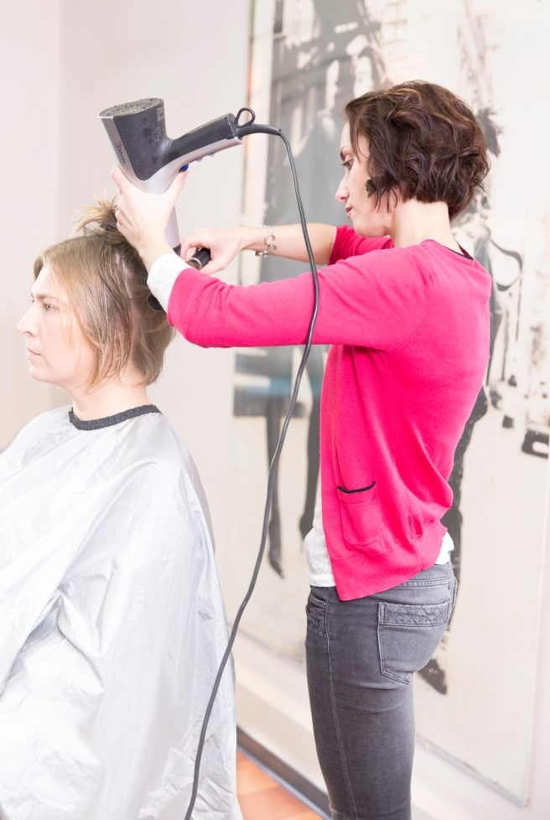
1. stage: preliminary study
Objectives:
Preparation of activity list
Recording of number and duration of individual activities
Assessment of potentially straining activities
Methodology:
Video analysis of five hairdressers in five salons during a shift
Attended to 46 clients

Slide 6
1. stage: results

Slide 7
1. stage: results
 | Activities (46 clients)
Ranking | Frequency [n] | Duration [min] | Proportion of time [%]
1st | Cutting (40) | Colouring (21) | Cutting (20)
2nd | Styling (34) | Perming (14) | Colouring (12)
3rd | Washing (31) | Cutting (13) | Blow-drying (7)
4th | Blow-drying (31) | Brows (12) | Washing (6)
… | … |  | < 5%

Slide 8
1. stage: results

Slide 9
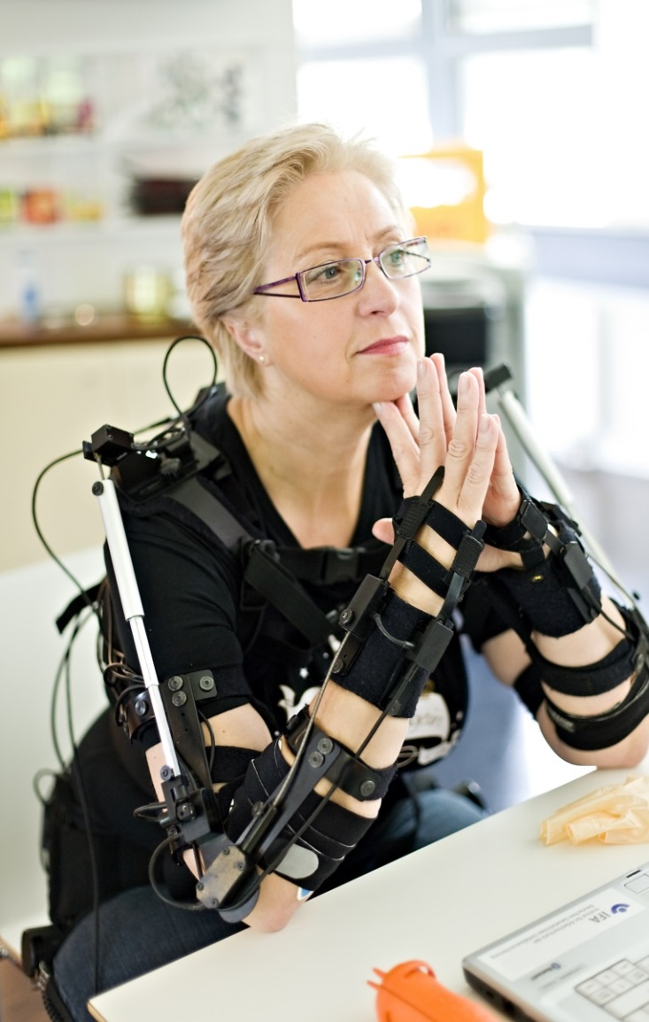
2. stage: feasibility study
Objectives:
Testing of measuring system for use in the hairdressing industry
Recording and evaluation of joint angles during the 4 main activities (cutting, colouring, blow-drying and washing)
Methodology:
Measurement of a hairdresser and three hair models (short, medium and long) under laboratory conditions

Slide 10
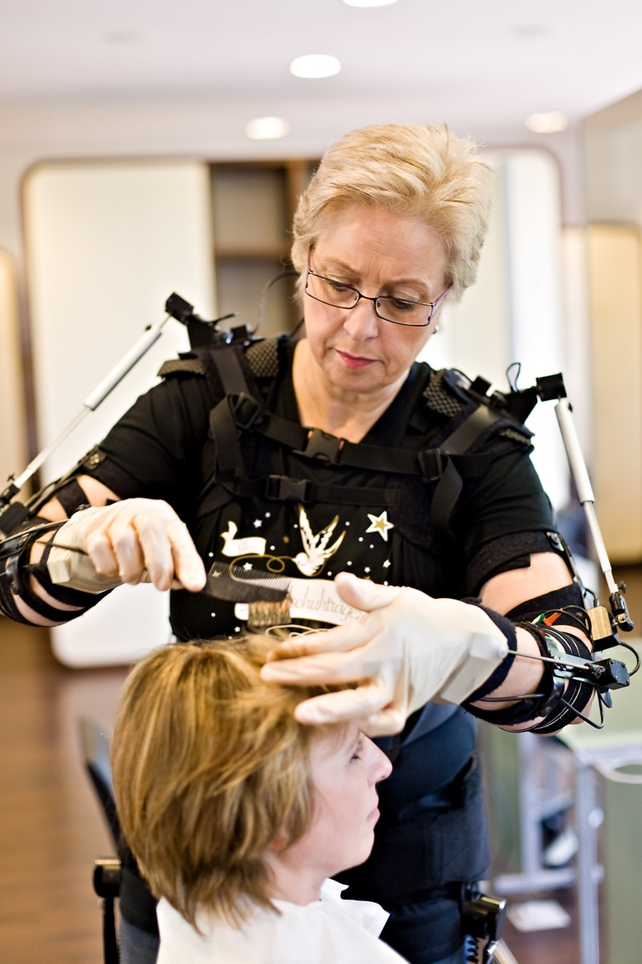
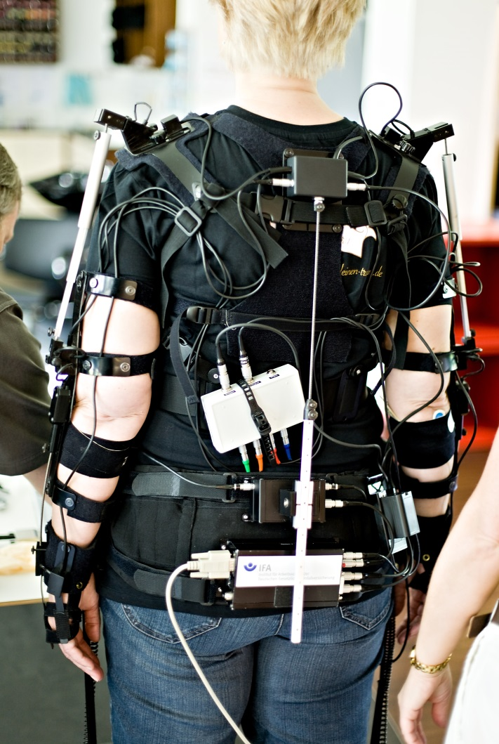
CUELA measurement system (CUELA: German abbreviation for „computer-assisted recording and long-term analysis of musculoskeletal loads”)

Slide 11
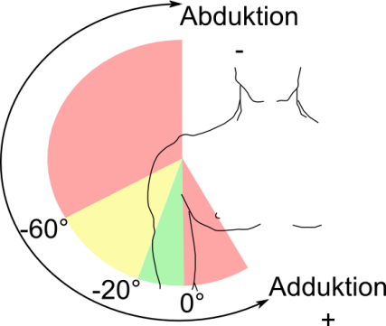
2. stage: ergonomic evaluation
How can postures be evaluated?
Magnitude
Duration (static postures)
Frequency
acceptable
limited acceptability
not acceptable
(DIN EN 1005-4, ISO 11226)

Slide 12
2. stage: results
Joint | Direction of movement | Cutting Proportion of time (%) |  | Colouring Proportion of time (%) |  | Blow-drying Proportion of time (%) |  | Washing Proportion of time (%)
 |  | left | right | left | right | left | right | left | right
Shoulder | Flexion | 46 | 55 | 28 | 28 | 16 | 49 | 16 | 8
 | Extension | 17 | 10 | 16 | 11 | 48 | 7 | 17 | 18
 | Abduction | 61 | 43 | 56 | 27 | 94 | 50 | 47 | 14
 | Adduction | 6 | 13 | 4 | 15 | 0 | 2 | 4 | 17
Elbow | Pronation | 21 | 64 | 36 | 56 | 13 | 56 | 34 | 64
 | Supination | 4 | 1 | 19 | 2 | 17 | 3 | 20 | 2
 | Flexion <60° | 6 | 6 | 10 | 14 | 1 | 4 | 18 | 18
 | Flexion >100° | 25 | 6 | 19 | 18 | 35 | 3 | 2 | 1
Hand | Flexion | 3 | 3 | 1 | 1 | 6 | 6 | 1 | 3
 | Extension | 28 | 8 | 14 | 4 | 4 | 12 | 26 | 1
Back | Curvature | 66 |  | 36 |  | 12 |  | 62
 | Rotation | 5 |  | 2 |  | 1 |  | 1
 | Incline to the left | 17 |  | 11 |  | 10 |  | 13
 | Incline to the right | 12 |  | 10 |  | 10 |  | 4

Slide 13
2. stage: results - repetition
Joint | Direction of movement | Cutting Repetition (no./min) |  | Colouring Repetition (no./min) |  | Blow-drying Repetition (no./min) |  | Washing Repetition (no./min)
 |  | left | right | left | right | left | right | left | right
Shoulder | Flexion/ extension | 7* | 10* | 12* | 15* | 19* | 14* | 14* | 11*
 | Abduction/ adduction | 8* | 10* | 7* | 12* | 10* | 15* | 12* | 8*
Elbow | Pronation/ supination | 18* | 24* | 14* | 27* | 23* | 28* | 23* | 15*
 | Flexion/ extension | 7 | 14* | 7 | 13* | 13* | 14* | 18* | 13*
Hand | Flexion/ extension | 13* | 24* | 8 | 33* | 23* | 50* | 16* | 19*
Joint | Reference values for a high degree of repetitiveness (according to Kilbom, 1994)
Shoulder | > 2.5/min
Elbow | > 10/min
Hand | > 10/min

Slide 14
2. stage: limitations
Only one test subject (senior hairdresser)
Very well trained and physically fit
=> Variety of possible working techniques, which have not been measured
=> Real average values likely to be significantly higher

Slide 15
3. stage: prevalence study
1280 businesses contacted by telephone
550 businesses participated
2159 questionnaires dispatched
889 questionnaires returned
=> Response rate: 41.2%

Slide 16
3. stage: results
Gender | Frequency [%]
Women | 90.6
Men | 9.4
Level of training | Frequency[%]
Trainee | 9.2
Fully-trained hairdresser | 52.8
Senior hairdresser | 35.4
Other | 2.5
Age | [%]
< 20 | 5
20 – 29 | 28
30 – 39 | 16
40 – 49 | 24
50 – 59 | 19
>= 60 | 8
Occupational status | [%]
Employed | 69.8
Self-employed | 28
Employed and self-employed | 2.2
Reduction of working hours due to MSDs: 13.4%

Slide 17
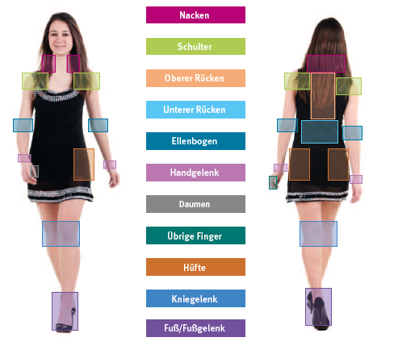

Slide 18
3. stage: results
Neck
Lower back
Shoulders
Upper back
Wrists
Feet
Knees
Hips
Thumbs
Fingers
Elbows
1-7 days
8-30 day
>30 days
daily

Slide 19
3. stage: results – influencing factors
 | Neck OR (crude) | Shoulders OR (crude) | Upper back OR (crude) | Lower back OR (crude)
BMI | - | - | - | -
Freelance (yes) | - | - | - | -
Sex (female) | 2.3 | - | - | -
Age (Jahre) | 1.017 | 1.026 | - | 1.016
Job experience (years) | 1.016 | 1.025 | - | 1.013
Working hours per week | - | - | 1.012 | -
Working hours reduced (yes) | 3.6 | 4.2 | 2.5 | 2.5

Slide 20
4. stage: main study / outlook
Identification of typical work and shift profiles
Ergonomic evaluation of these profiles
=> Identification of physiological and non- physiological movement sequences
=> Identification of preventive measures
=> Making hairdressers aware of non- physiological postures / movements

Slide 21
Summary
Hairdressing involves many different activities
Multiple stressful postures and repetitive movements
Higher proportion of MSDs primarily in the neck, shoulders and upper and lower back
Huge potential for ergonomic improvements

Slide 22
Thank you very much for your attention.

