Slide 1


THE VOLUNTARY STANDARDIZATION
A FRAMEWORK FOR PROGRESS FOR ALL
Standardization
A framework
For progress
For all
Jean-Loup COMMO
Isabelle GALLINELLI
33 (0)1 41 62 86 33
jeanloup.commo@afnor.org
33 (0)1 41 62 84 09
isabelle.gallinelli@afnor.org

Slide 2
?
A VOLUNTARY
STANDARD,
WHAT IS IT

Slide 3















A FRAMEWORK FOR REFERENCE
A voluntary standard provides guidelines, technical or qualitative requirements for products, services or practices
It thus provides a framework for reference for all professional sectors
Digital information & communication
Industrial engineering, capital goods and materials
Electro-technologies
Petroleum
Rational use of energy
Gas
Consumer goods, sports and leisure
Management & services
Environment and social responsibility
Water large cycle
Agri-food
Transport & logistics
Occupational health and safety
Health and social action
Construction and urban planning

Slide 4

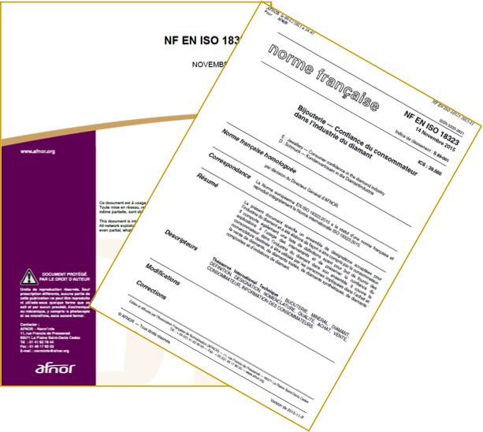

A collectively co-produced tool
OF VOLUNTARY IMPLEMENTATION
It is the market players who :
propose its elaboration
develop it by consensus, within a dedicated collective of work
validate it
and implement it
THE STANDARD IS VOLUNTARY
You can participate or not in it
and refer or not to it
Do not confuse standard (voluntary)
and regulation (mandatory)

Slide 5
THE VOLUNTARY STANDARD
SERVING THE GENERAL INTEREST
For businesses, the voluntary standard is synonymous with performance, competitiveness, quality, innovation and safety
For the company staff, it improves working conditions and safety
For public stakeholders, it helps to implement public policies and to address societal issues
For local authorities, it facilitates and simplifies their consultations and purchases
For consumers, it improves their trust in the purchased products and services
‘‘
‘‘
La normalisation identifie de manière consensuelle les bonnes pratiques et les associe durablement à la vie de l’entreprise.
Le responsable de l’une des divisions Ingénierie d’EDF

Slide 6




THE VOLUNTARY STANDARD
IN FIGURES IN France (2016)
90%
of the standards are of European or international origin
633
34 674
new standards have been published
voluntary standards exist.
They concern all sectors of the world economy
334
standards have been withdrawn
1 334
standards have been revised
Source chiffres AFNOR 2016

Slide 7
!
THE STANDARDIZATION :
BENEFITS FOR YOUR WHOLE ORGANIZATION

Slide 8
A TOOL THAT PARTICIPATES FULLY IN THE DEVELOPMENT OF YOUR ORGANIZATION
Use standards as a lever for deploying your R&D
Perform an active strategic intelligence on your sector
Improve the efficiency and performance of your products / services
Increase your turnover and develop your export
Have strong arguments to differentiate yourself from the competition
Enhance your image by communicating about your participation in standardization

Slide 9
STANDARDIZATION
IS SIMPLE AND WE ACCOMPANY YOU

Slide 10
WE ACCOMPANY YOU
WE BUILD THE FRAMEWORK
  We support you in integrating standardization into your strategy
  We animate and coordinate the work (from identification of needs to feedback)
  We put our profession and our normative engineering experience at your service to provide you with strategic and tactical support
YOU DESIGNE THE STANDARD
  You work on the content of standards
  You share your technical skills and your knowledge of the sector issues
  You promote and defend your positions
  You participate in decision-making

Slide 11






STANDARDIZATION STEP BY STEP
Proposition
Study
Collective
development
Revision
Validation and
publication
Study
of comments
Enquiry

Slide 12
THE VOLUNTARY Standardization : who ASKS FOR IT ?
Public authorities
To support regulatory requirements
European Commission
Standardization requests
  The standardization
  A tool at the service of operators
NGO
Consumers
  To protect individuals, the environment
Professional federations
For collective technical / political actions
Assesors
To give guarantees
Enterprises
Individual actions with collective aim

Slide 13
THE CEN DELIVRABLES
Among the 4 CEN deliverables, 2 options
 | European standard (EN) | CEN Worskshop Agreement (CWA)
Status | Standard adopted by CEN | CEN document, developed by a Workshop, which reflects an agreement between identified individuals and organizations responsible for its contents
Participation | All interested parties via national delegations to a CEN Technical Committee | Registered Workshop participants → direct participation of anyone
Standstill | Standstill | No standstill
Approval | CEN members | Consensus among Workshop registered participants
National implementation | Obligation of implementation as an identical national standard (NF EN, DIN EN, BS EN, …) and withdrawal of conflicting national standards | Announcement
Maintenance | Review (5 years) | 3 years (6 years max)

Slide 14
DEVELOPPING A EUROPEAN STANDARD (EN)
Principles : consensus, openness, transparency, national commitment and technical coherence
Steps :
  proposal for new work
  → Technical Body existing or to be created
  Standstill
  Drafting → the draft EN is developed (in English) by experts within a Technical Body
  Enquiry → Public comment at national level (8 weeks) & weighted vote
  Formal Vote (weighted)
  If the results of the Enquiry show that the draft EN requires technical reworking
  Publication
  The EN must be implemented at national level in all CEN member countries (34) by being given the status of national standards and any conflicting national standard shall be withdrawn
  Review (< 5 years → confirmation, or revision or withdrawal)

Slide 15
DEVELOPPING A CEN Workshop Agreement (CWA)
Project Plan | Kick-off Meeting | Drafting and adoption of CWA | Publication of CWA
Describing Scope Objectives Work plan Deliverable(s) Financing | Confirming Project Plan : Deliverable(s) Rules of the Workshop Financing Chairmanship Secretariat | Consensus Process Workshop registered participants Open commenting phase (60 days) | Announced By CEN or CENELEC National Members
Timeframe : 6 - 18 months (av.)

Slide 16
FUNDING
Development of EN(s)
  TC Secretariat
  WG Secretariat (optional)
Development of CWA(s)
  WS Secretariat

Slide 17
In summary
THE VOLUNTARY STANDARDIZATION
A FRAMEWORK FOR PROGRESS FOR ALL
You collectively decide to create a standard
You participate fully in its elaboration
Together, we contribute to the improvement of products, services and practices, for your competitiveness and, more generally, for the progress of the economy and society
We accompany you and provide support and advice

Slide 18


